Slide 1
Chapter 3
Drawing In the World

Slide 2
This Chapter
Create and draw multiple rectangular objects
Control the position, size, rotation, and color of the created rectangular objects
Define a coordinate system to draw from
Define a target subarea on the canvas to draw to
Work with abstract representations of renderable objects, transformation operators, and cameras

Slide 3
Coordinate Space and Pixels
Bad to think pixels:
Same game to run on a phone (low pixel count) and high resolution desk top monitor
Game object reference …
In a chess game
In a soccer game
Need for coordinate system support
Cartesian Coordinate System: origin and axes

Slide 4
Game World and Viewport
What coordinate system the game objects should be defined in?
Idea: need a “Game world coordinate system”
Which of the game objects should be drawn?
Idea: need a “Camera”
Where should the game objects be drawn to?
Idea: need a “Viewport”

Slide 5
Encapsulating Drawing
Drawing with WebGL is messy and non-trivial
Define object to hide the drawing operation
Goal:
No need to worry about drawing
Can focus on thinking and building game-specific support

Slide 6

3.1: Renderable Object Project

Slide 7
To begin the process of building an object to encapsulate the drawing operations by first abstracting the drawing functionality
To demonstrate how to create different instances of SimpleShader
To demonstrate the ability to create multiple Renderable objects

Slide 8
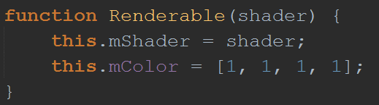
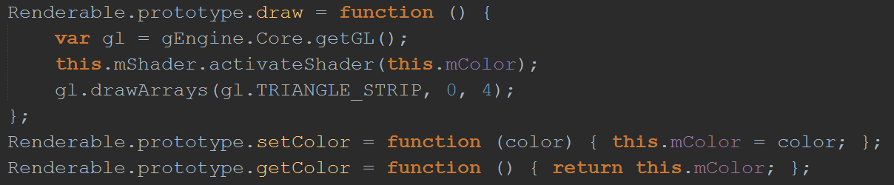
3.1: The Renderable Object
Renderable.js

Slide 9
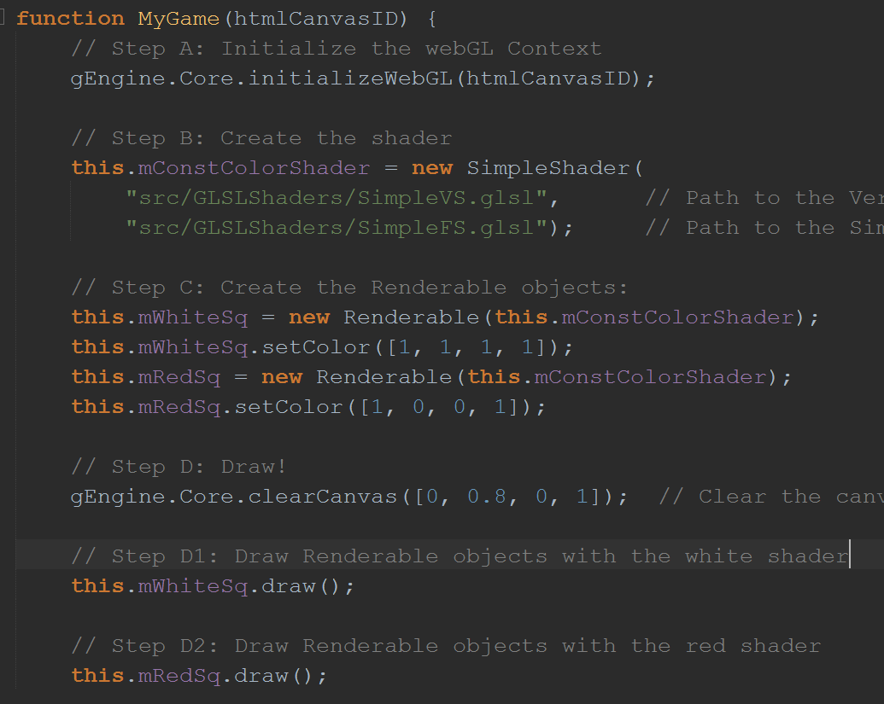
3.1: Testing the Renderable Object
MyGame.js

Slide 10
3.1: Testing the Renderable Object
MyGame.js

Slide 11
3.1: Observations and Problems?
Two squares are drawn, only see one?!
Overlapped
Later drawn overlaps on earlier drawn
What can be done?
Draw to different locations
Approach:
A: Define new square geometries (must transform from CPU to GPU)
B: Define ways of transforming the defined geometry

Slide 12
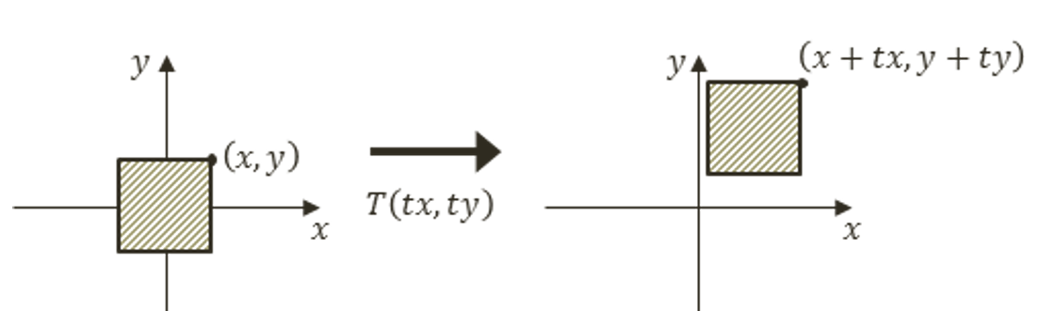
Matrix Transformation: Translate
Matrix: black box operator
Translation:

Slide 13
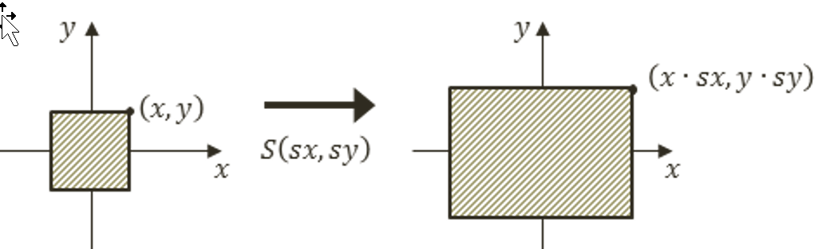
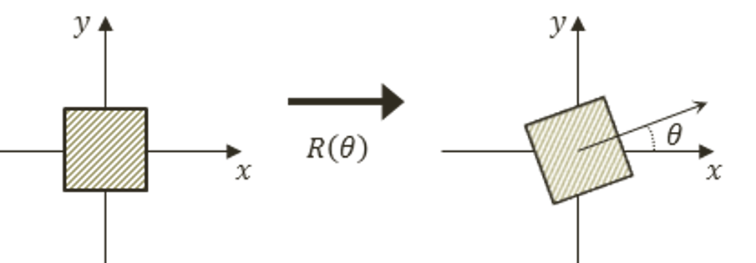
Matrix Transformation: Scale and Rotate
Scaling
Rotation:

Slide 14
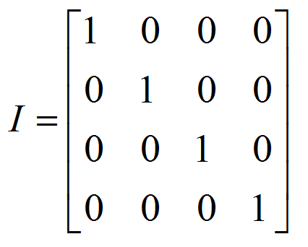
Matrix Transformation: Identity
Identity: no-op
Always transform on vertices:
M: a matrix operator
p: a vertex position
p' is the transform of p by M:
p' = Mp
(Multiple p by M)

Slide 15
Matrix Transformation: Concatenation
If
p is a vertex position
T, R, S: three matrix operators
p‘ = T R S p
vp‘ is the result of S operating on p, followed by R, and lastly by T
Then
Compute new operator: M = T R S
p‘ = M p
M can be applied to any vertex position (same effect as T R S)
More efficient then applying T R S separately!
Order is important!
T S <> S T

Slide 16
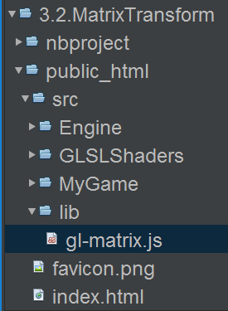
glMatrix.js: Matrix operator library
Download from http://glMarix.net
Load into project:

Slide 17
glMatrix.js: Matrix operator library
Download from http://glMarix.net
Load into project:

Slide 18
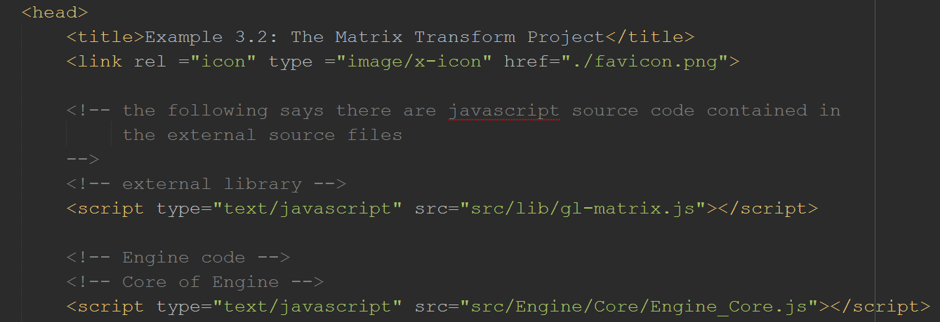
glMatrix.js: Matrix operator library
Download from http://glMarix.net
Load into project:
Load glMarix.js in index.html:
Index.html

Slide 19
glMatrix.js: Matrix operator library
Download from http://glMarix.net
Load into project:
Load glMarix.js in index.html:
Index.html

Slide 20
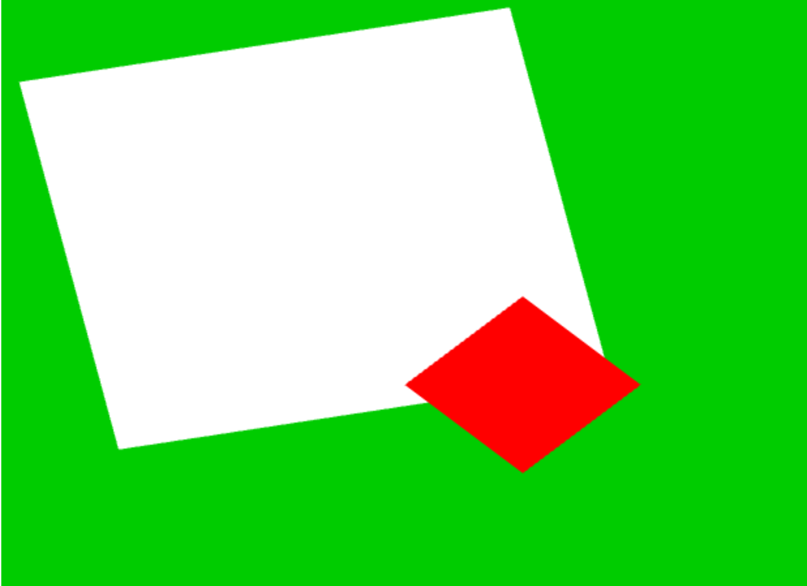
3.2: Matrix Transform Project

Slide 21
3.2: Goals
To introduce transformation matrices as operators for drawing a Renderable
To understand how to work with the transform operators to manipulate a Renderable

Slide 22
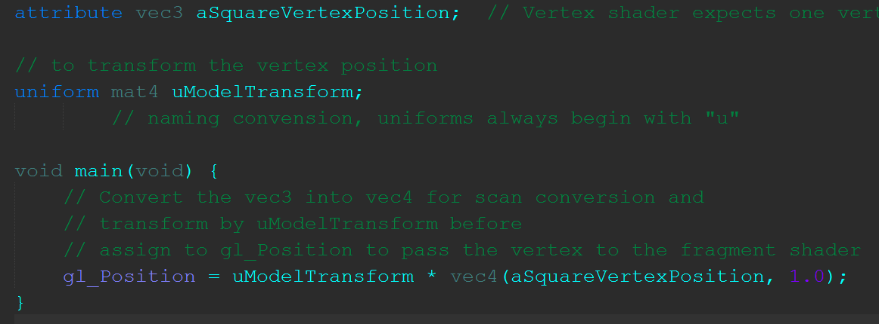
3.2: Vertex Shader with Transform Support
SimpleVS.glsl

Slide 23
3.2: Vertex Shader with Transform Support
New uniform (load once) variable for matrix operator
SimpleVS.glsl

Slide 24
3.2: Vertex Shader with Transform Support
New uniform (load once) variable for matrix operator
SimpleVS.glsl
Transform vertex by the uniform matrix operator

Slide 25
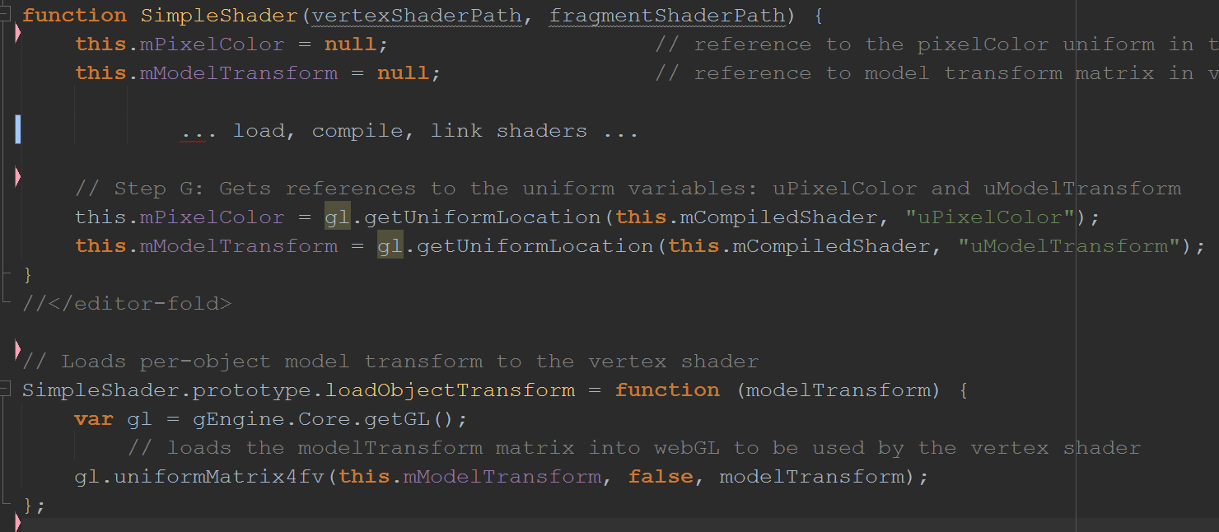
3.2: SimpleShader object
SimpleShader.js

Slide 26
3.2: SimpleShader object
SimpleShader.js
Keep a reference to the uniform variable transform operator

Slide 27
3.2: SimpleShader object
SimpleShader.js
Support loading of operator to the unform variable during runtime

Slide 28
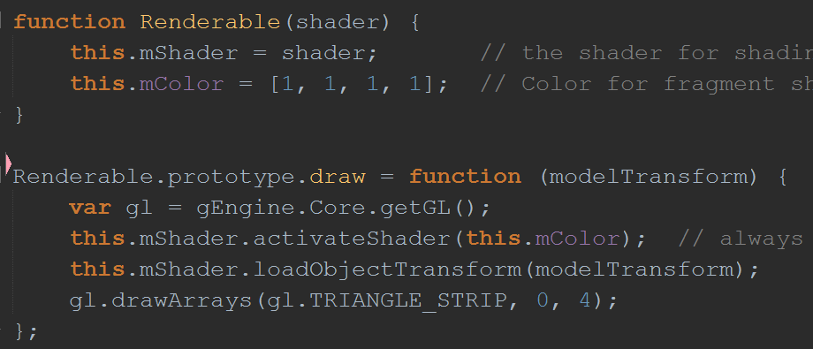
3.2: Renderable Support for Transformation
Renderable.js

Slide 29
3.2: Renderable Support for Transformation
Renderable.js

Slide 30
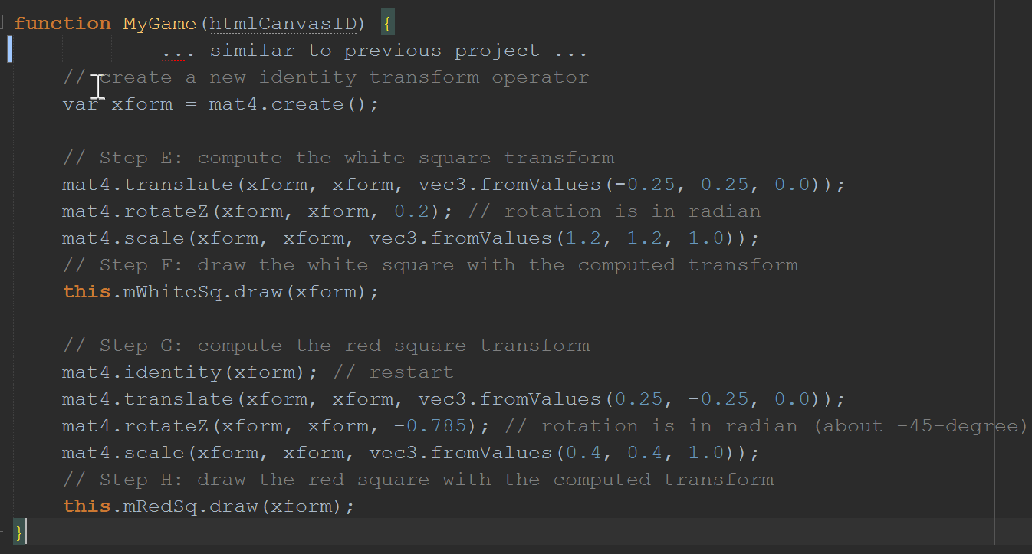
3.2: MyGame Testing of Transform
MyGame.hs

Slide 31
3.2: MyGame Testing of Transform
MyGame.hs

Slide 32
3.2: MyGame Testing of Transform
MyGame.hs

Slide 33
Question: What does this do?
// create a new identity transform operator
var xform = mat4.create();
mat4.translate(xform, xform, vec3.fromValues(-0.5, 0.5, 0.0));
mat4.rotateZ(xform, xform, 3.14/4); // rotation is in radian
mat4.scale(xform, xform, vec3.fromValues(0.25, 0.25, 1.0));

Slide 34
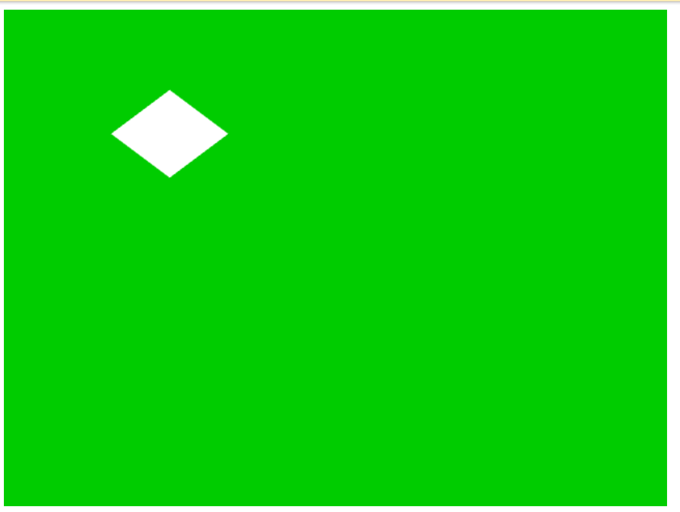

Slide 35
Question: How about this?
// create a new identity transform operator
var xform = mat4.create();
mat4.scale(xform, xform, vec3.fromValues(0.5, 0.5, 1.0));
mat4.rotateZ(xform, xform, 3.14/4); // rotation is in radian
mat4.translate(xform, xform, vec3.fromValues(-0.5, 0.5, 0.0));

Slide 36
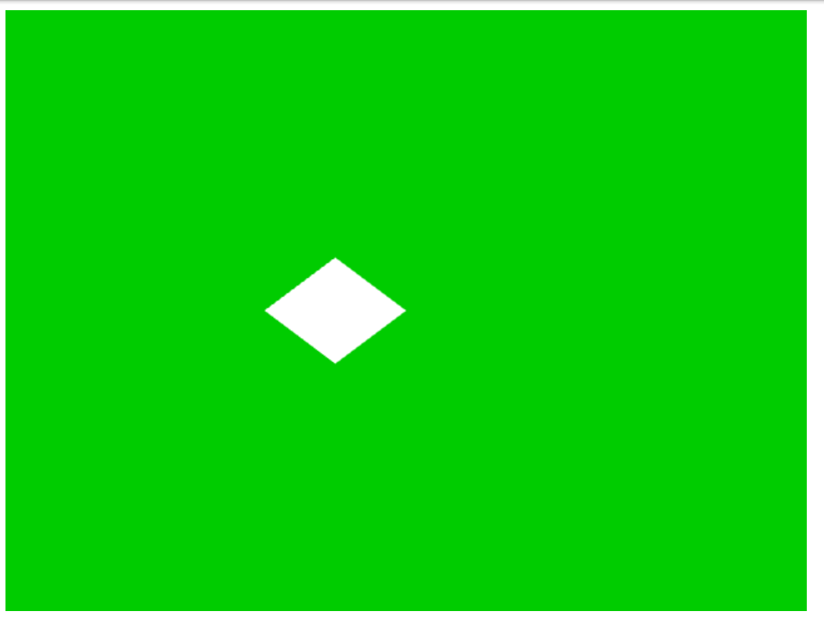

Slide 37
Learned?
Multiplication ordering is IMPORTANT
M = TRS
Is “intuitive”
Rotation after Scaling
Last: translation
No “unexpected” movements!

Slide 38
3.3: Encapsulating Transform

Slide 39
3.3: Goals
To create the Transform object so it can encapsulate the matrix transformation functionality
To integrate the Transform object into the game engine
To demonstrate how to work with the Transform object

Slide 40
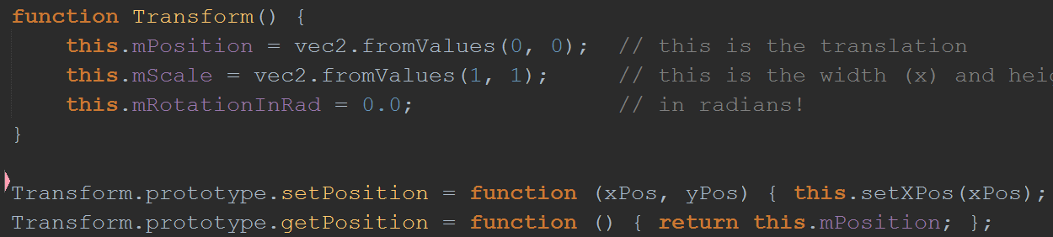
3.3: The Transform object
Transform.js
Other set/get functions

Slide 41
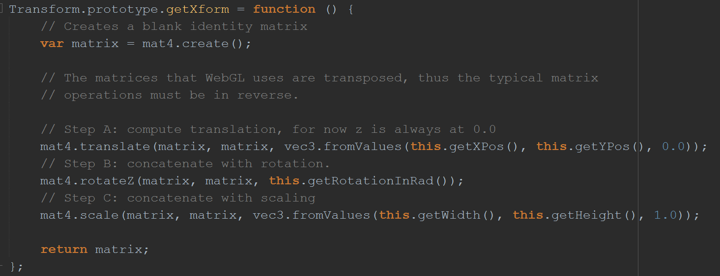
3.3: The Transform Object
Computes: T R S
Most intuitive for users

Slide 42
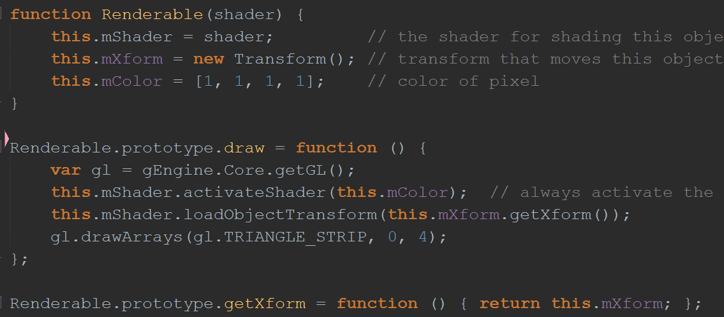
3.3: Renderable Object with Transform
Renderable.js

Slide 43
3.3: Renderable Object with Transform
Renderable.js

Slide 44
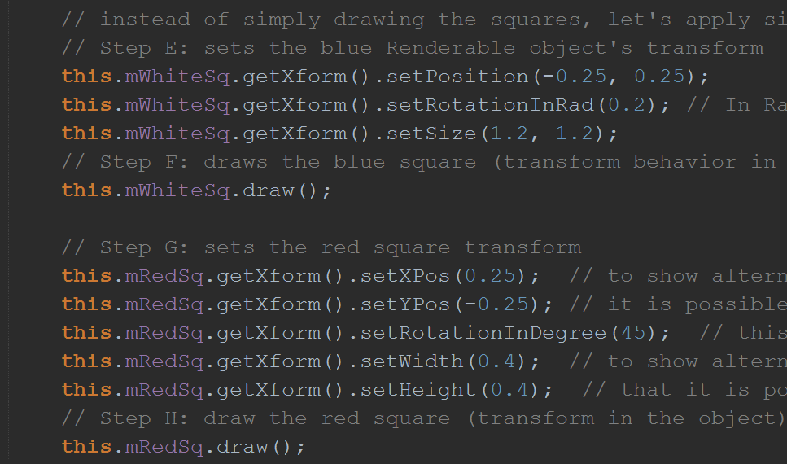
3.3: Testing Renderable with Transform
MyGame.js

Slide 45
3.3: Testing Renderable with Transform
MyGame.js

Slide 46
3.3: Testing Renderable with Transform
MyGame.js

Slide 47
Question: What happens?
this.mSq.getXform().setPosition(20, 30);
this.mSq.getXform().setRotationInDegree(90); // In Degrees
this.mSq.getXform().setSize(4, 2);
// what is defined?
this.mSq.draw();
// what will I see?

Slide 48
Coordinate Systems and Viewport
Design a soccer game
Where are the center of the field, goal posts? What unit should you use?
You probably want: units in Meters?
Center of field at (0,0) or Left court boundary is X=0?
Design a chess game
Where are the locations of the King, Queen, and Knight?
Probably coordinate in discrete locations (1.5, 1.5) does _NOT_ make sense?!
Display to where in the canvas?
What if you want to reserve part of canvas for UI?

Slide 49
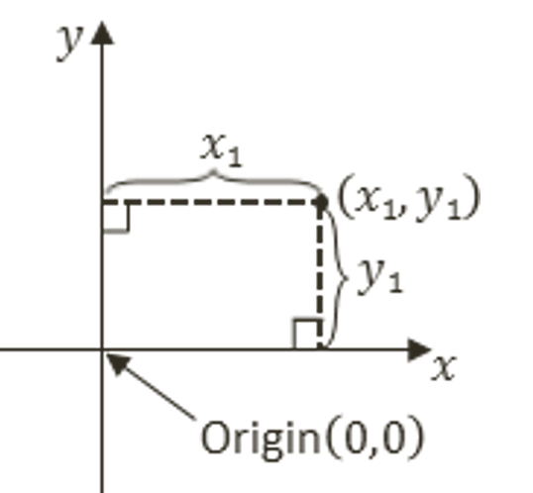
Cartesian Coordinate System
What we want?
Game coordinate system should be user defined!
Origin, Axes (x/y), units are implicit!

Slide 50
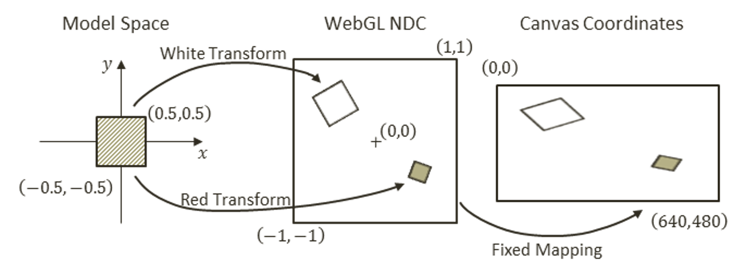
Currently: Drawing
Model space:
Defines the unit square
Vertex Buffer “uModelTransform” transforms into NDC
NDC is drawn on to the canvas automatically!

Slide 51
Currently: Drawing
Model space:
Defines the unit square
Vertex Buffer “uModelTransform” transforms into NDC
NDC is drawn on to the canvas automatically!

Slide 52
Currently: Drawing
Model space:
Defines the unit square
Vertex Buffer “uModelTransform” transforms into NDC
NDC is drawn on to the canvas automatically!

Slide 53
Currently: Drawing
Model space:
Defines the unit square
Vertex Buffer “uModelTransform” transforms into NDC
NDC is drawn on to the canvas automatically!
MyGame.js

Slide 54
Currently: Drawing
Model space:
Defines the unit square
Vertex Buffer “uModelTransform” transforms into NDC
NDC is drawn on to the canvas automatically!
MyGame.js
Renderable.js

Slide 55
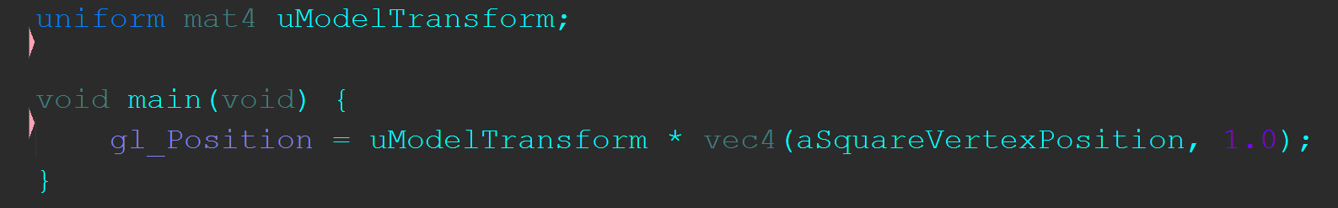
Currently: Drawing
Model space:
Defines the unit square
Vertex Buffer “uModelTransform” transforms into NDC
NDC is drawn on to the canvas automatically!
MyGame.js
Renderable.js
SimpleVS.glsl

Slide 56
All the Coordinate Systems
Modeling Coordinate:
The unit square between (-0.5, -0.5) to (0.5, 0.5)
Normalized Device Coordinate (NDC)
(-1, -1) to (1, 1)
The default drawing space for WebGL
Canvas Coordinate Space (or Device Coordinate Space)
Hardware pixel drawing area, units in pixels
BUT … we need more …

Slide 57
What’s wrong
Our user (MyGame.js) must think in terms of NDC
Everything must be between -1 to 1
Does not work with Soccer or Chess!
Need something in between
Model Coordinate (the unit square)
and
NDC (-1 to 1)
Need: … World Coordinate System

Slide 58
The World Coordinate (WC) System
Let our user define a convenient coordinate system
E.g., (0, 0) to (100, 60) for a soccer field
E.g., (0, 0) to (24, 24) for chess board
Let our user move their objects in their coordinate system
E.g., a play on the soccer field has a size of 1x2, located at (50, 30)
E.g., a chess piece is of size 0.8x0.8, and located at position (3, 5)
Remember:
WebGL only knows how to draw everything within NDC
MUST: transform user defined coordinate system (WC) to NDC

Slide 59
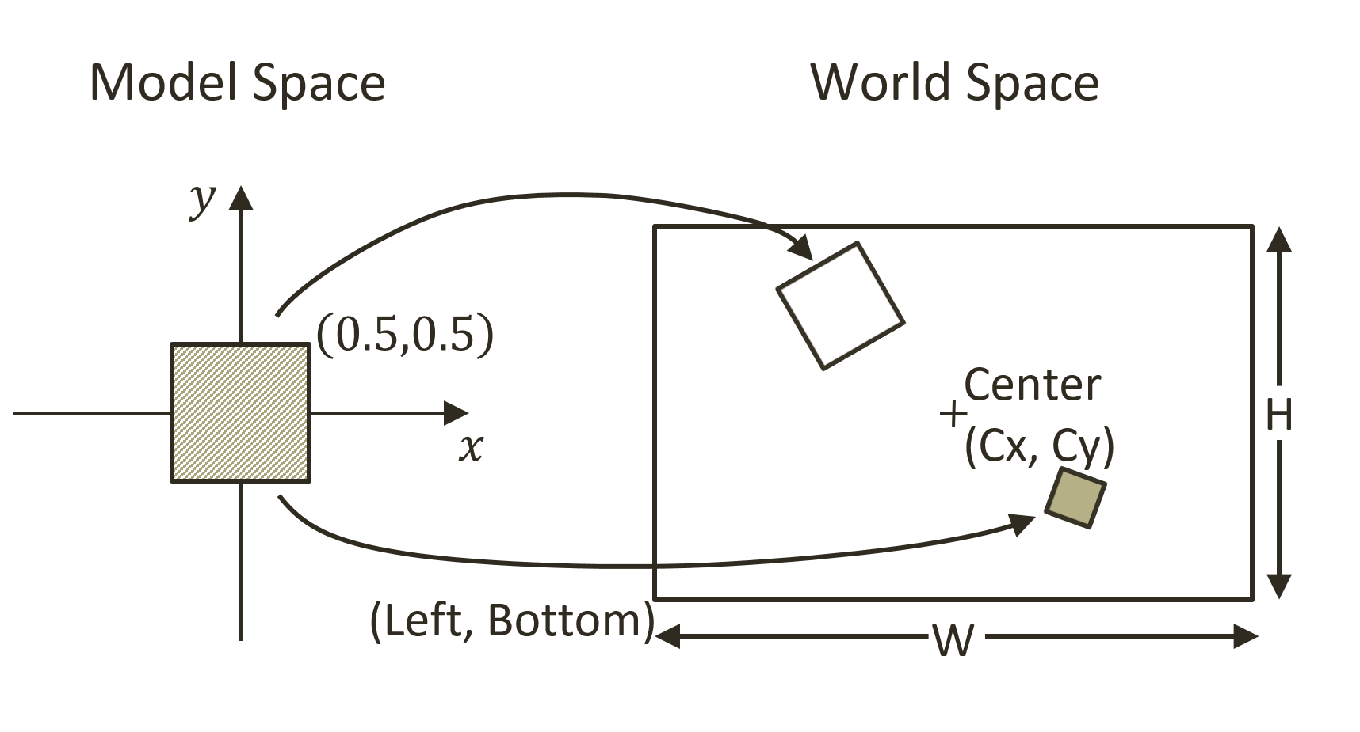
World Coordinate System

Slide 60
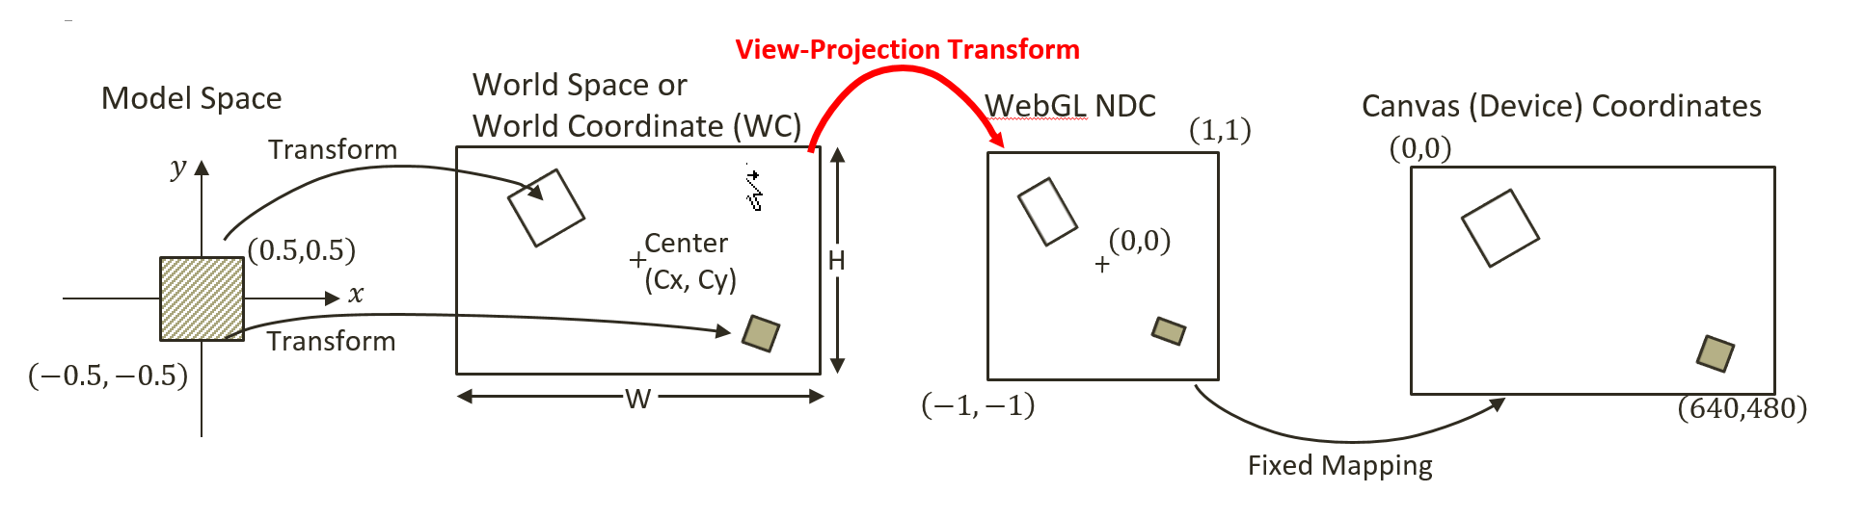
The View-Projection Transform

Slide 61
The View-Projection Transform

Slide 62
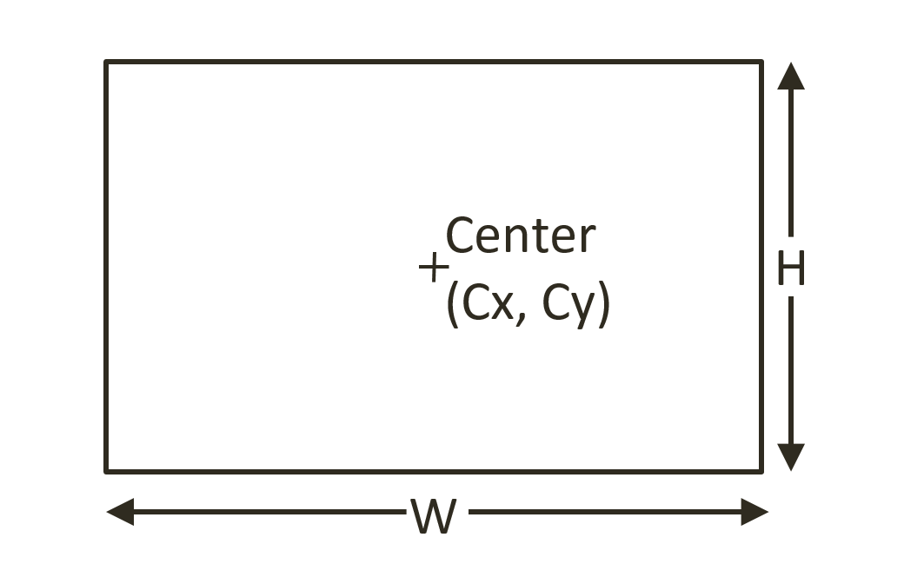
vpMatrix: lookAt() and ortho()
mat4.lookAt(viewMatrix, [cx, cy, 10], // (cx,cy) is center of the WC [cx, cy, 0], [0, 1, 0]); // orientation
mat4.ortho(projMatrix, -W/2, // distant from (cx,cy) to left of WC W/2, // distant from (cx,cy) to right of WC -H/2, // distant from (cx,cy) to bottom of WC H/2, // distant from (cx,cy) to top of WC 0, // the z-distant to near plane 1000 // the z-distant to far plane );
vpMatrix = projMatrix × viewMatrix

Slide 63
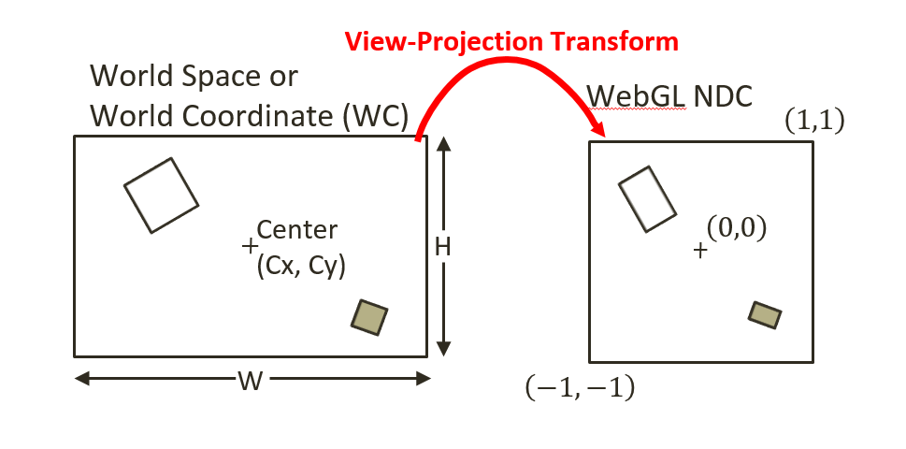
What is done by lookAt() and ortho()?
vpMatrix = projMatrix × viewMatrix
… is simply …
translating (Cx, Cy) to (0, 0)
scaling WxH to 2x2
OR … vpMatrix = S(2/W, 2/H) T(-Cx, -Cy)

Slide 64

Question: How to set up … ?
this.mSq.getXform().setPosition(20, 30);
this.mSq.getXform().setRotationInDegree(90); // In Degrees
this.mSq.getXform().setSize(4, 2);
// How to set vpMatrix to see …
// Assume: square canvas! (e.g., 500x500)
// position: in the center of canvas
// size: 50% width and height of canvas

Slide 65
Answer:
Center on object
mat4.lookAt(viewMatrix,
[20, 30, 10], // camera position
[20, 30, 0], // look at position
[0, 1, 0]); // orientation
// Step F2: define the projection matrix
mat4.ortho(projMatrix,
-2, // distance to left of WC
2, // distance to right of WC
-4, // distance to bottom of WC
4, // distance to top of WC
0, // distance to near plane
1000); // distance to far plane
var vpMatrix = mat4.create();
mat4.multiply(vpMatrix, projMatrix, viewMatrix);
Visible width is: 4
Visible Height is: 8

Slide 66

Question: How about this?
this.mSq.getXform().setPosition(20, 30);
this.mSq.getXform().setRotationInDegree(90); // In Degrees
this.mSq.getXform().setSize(4, 2);
// How to set vpMatrix to see …
// Assume: square canvas! (e.g., 500x500)
// position: in the center of canvas
// size: almost covers the entire canvas

Slide 67
Answer:
Center on object
mat4.lookAt(viewMatrix,
[20, 30, 10], // camera position
[20, 30, 0], // look at position
[0, 1, 0]); // orientation
// Step F2: define the projection matrix
mat4.ortho(projMatrix,
-1.1, // distance to left of WC
1.1, // distance to right of WC
--2.1, // distance to bottom of WC
2.1, // distance to top of WC
0, // distance to near plane
1000); // distance to far plane
var vpMatrix = mat4.create();
mat4.multiply(vpMatrix, projMatrix, viewMatrix);
Visible width is: 2.2
Visible Height is: 4.2

Slide 68
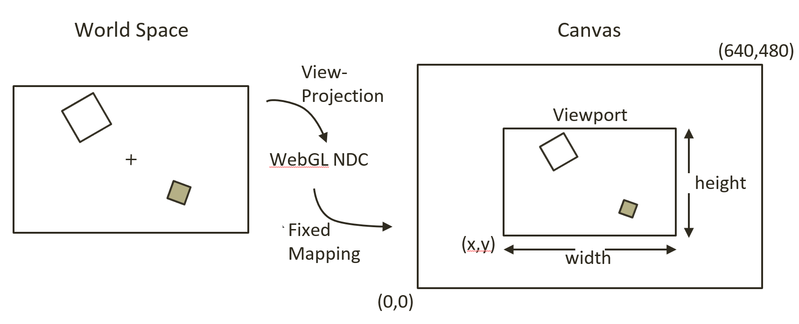
WebGL Viewport
gl.viewport( x, // x position of bottom-left corner of the area to be drawn y, // y position of bottom-left corner of the area to be drawn width, // width of the area to be drawn height // height of the area to be drawn );

Slide 69
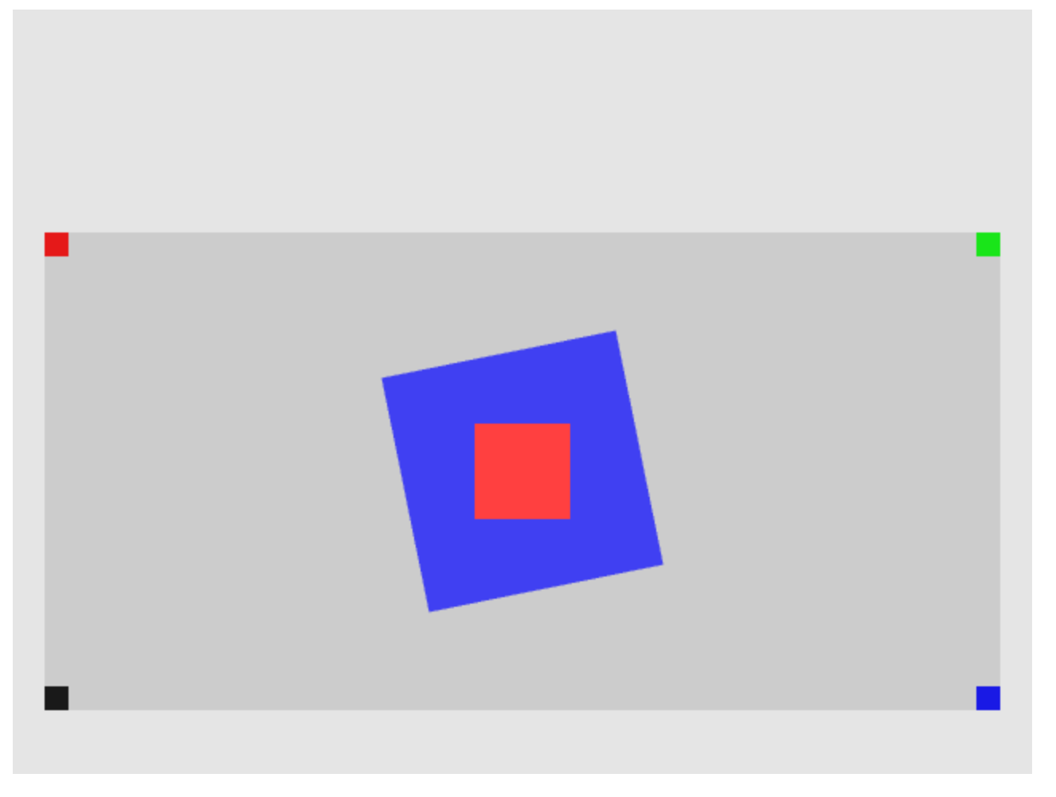
3.4: View Projection and Viewport

Slide 70
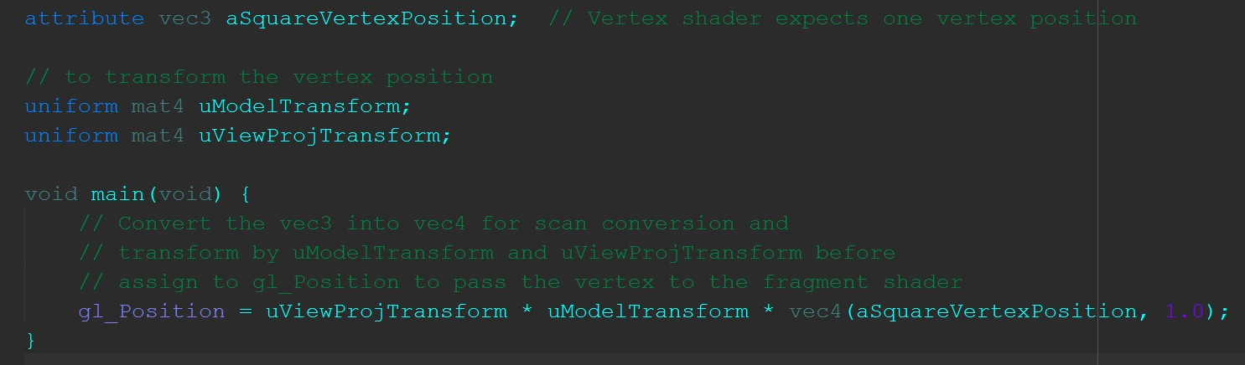
3.4: Vertex Shader Support for ViewProjection
SimpleVS.glsl

Slide 71
3.4: Vertex Shader Support for ViewProjection
SimpleVS.glsl

Slide 72
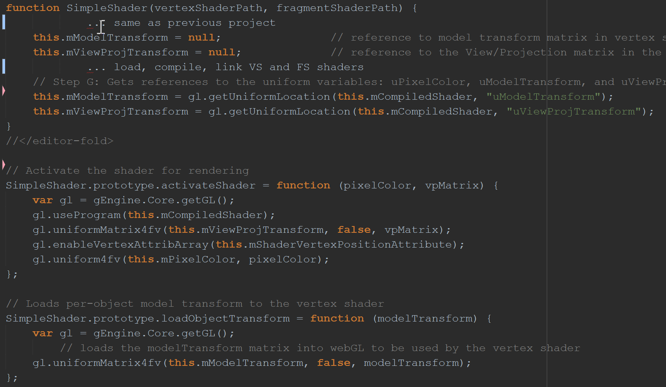
3.4: SimpleShader modification

Slide 73
3.4: SimpleShader modification

Slide 74
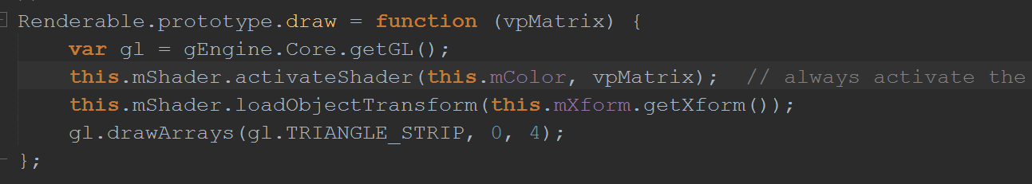
3.4: Modify Renderable.draw()

Slide 75
3.4: Modify Renderable.draw()

Slide 76
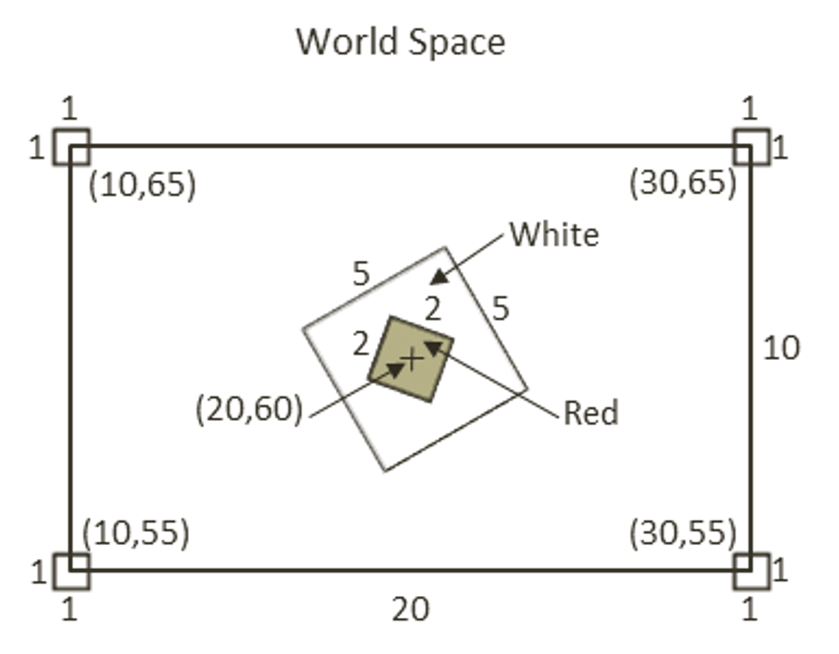
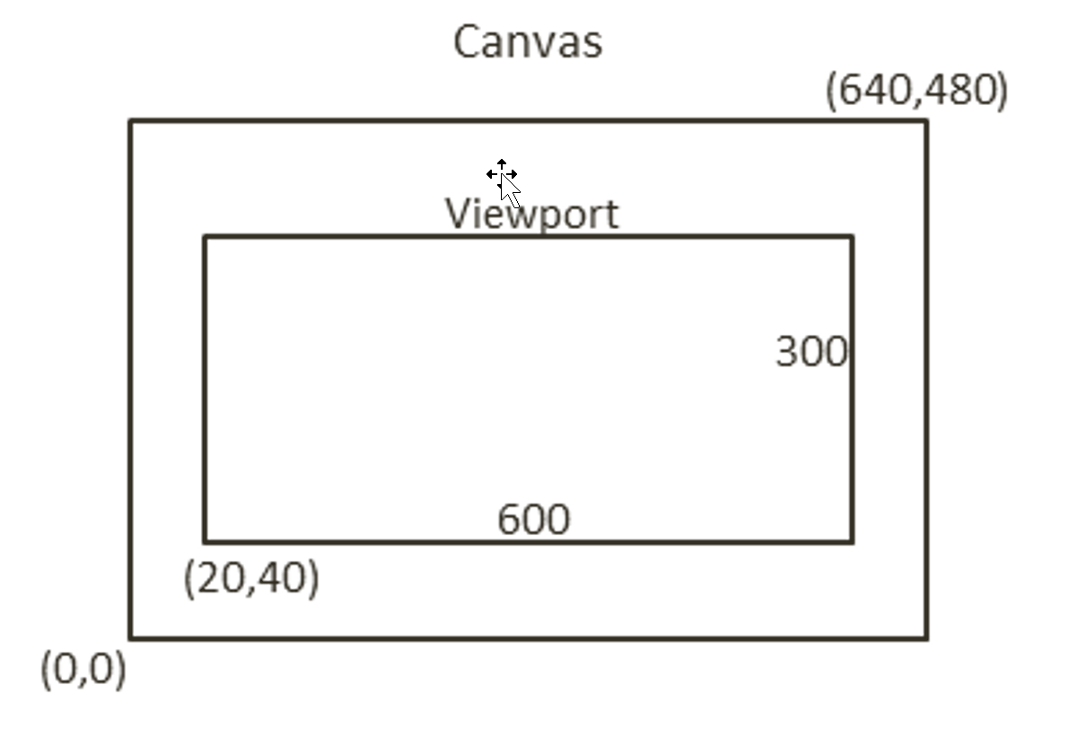
3.4: Testing View Projection and Viewport
Design of the test:

Slide 77
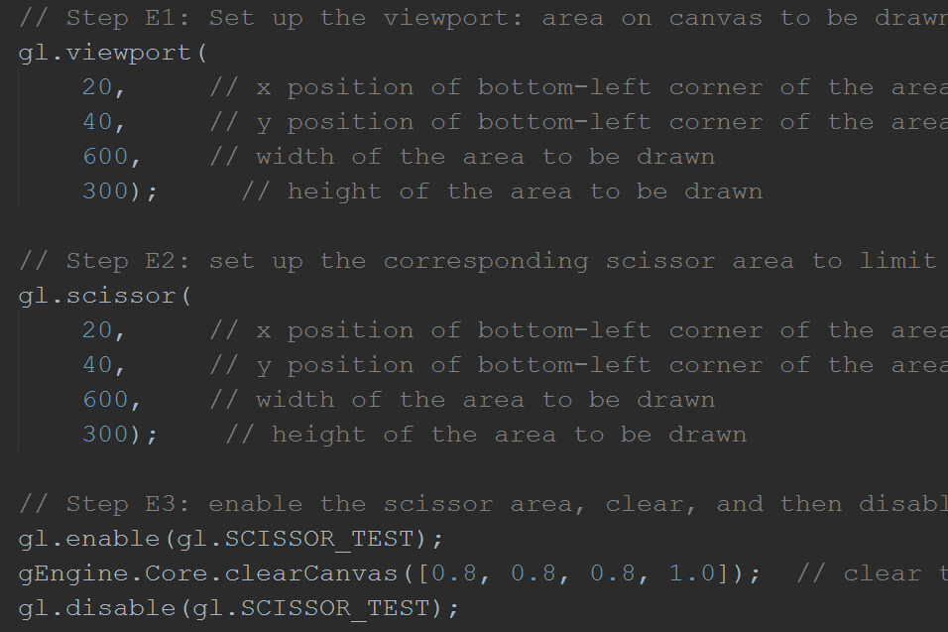
3.4: Setup Viewport
MyGame.js

Slide 78
3.4: Note on gl.scissor()

Slide 79
Viewport vs. Scissor
gl.viewport() defines where NDC is mapped to
Implicitly performed by WebGL
gl.scissor() defines area that can be drawn to!
Does not affect anything else
Expensive operation!
That’s why, enable/clear/disable

Slide 80
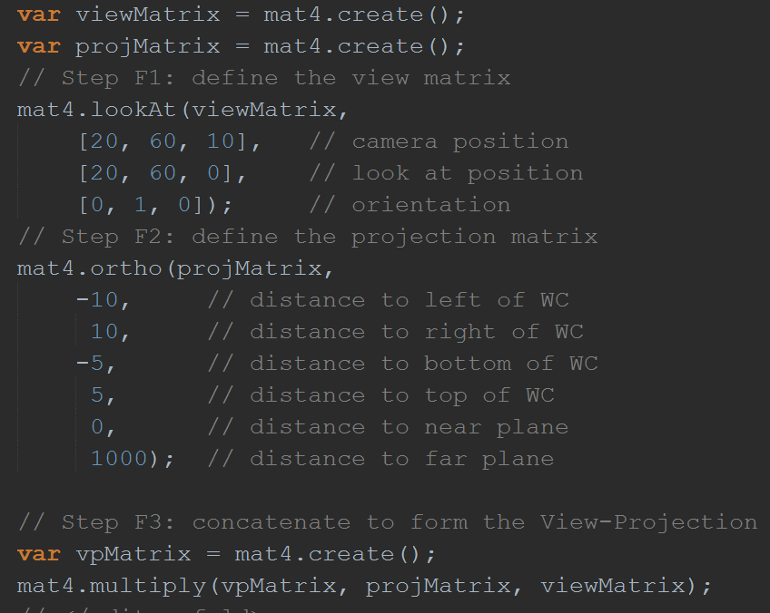
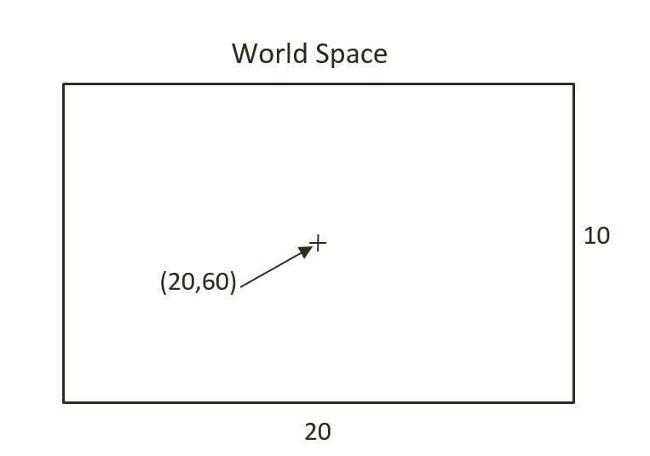
3.4: Setup View Projection
MyGame.js

Slide 81
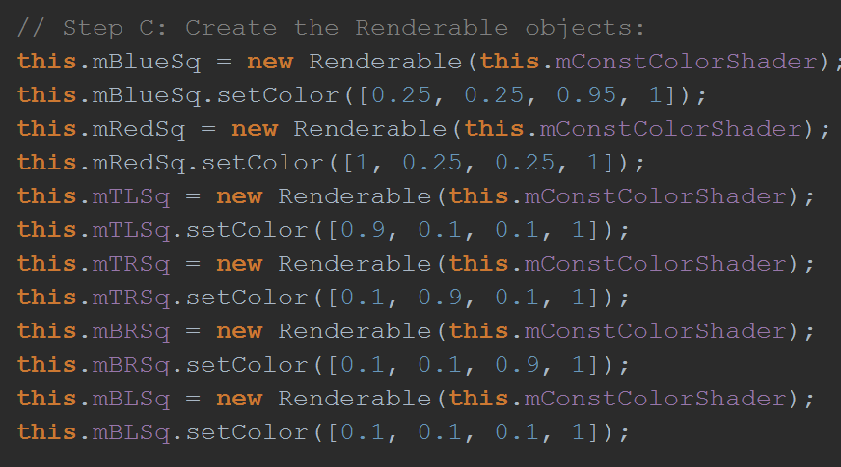
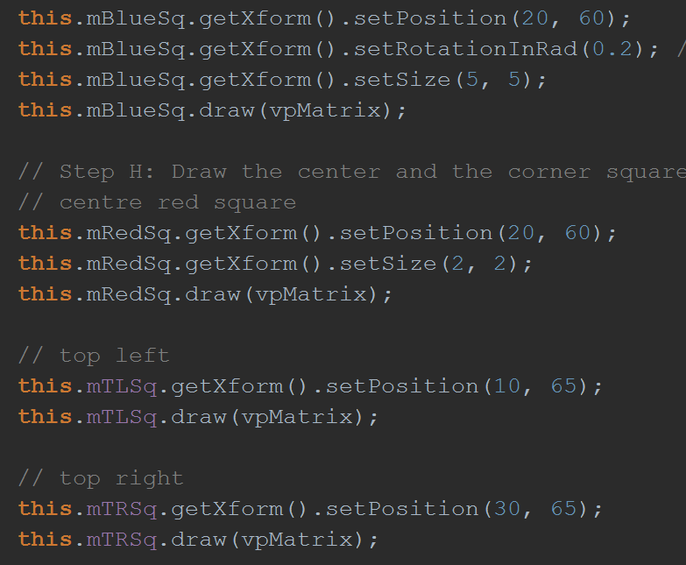
3.4: Implementing the test
MyGame.js

Slide 82
3.5: The Camera
Observation from 3.4
Viewport and View Projection setting
Messy and makes MyGame.js difficult to read
Need an abstraction … the Camera!
Camera:
WC Center: where is the camera viewfinder
WC Width/Height: what can be seen through the camera
Viewport: where to show the WC on the film

Slide 83
3.5: Goals
To define the Camera object to encapsulate the definition of WC and the viewport functionality
To integrate the Camera object into the game engine
To demonstrate how to work with the Camera object

Slide 84
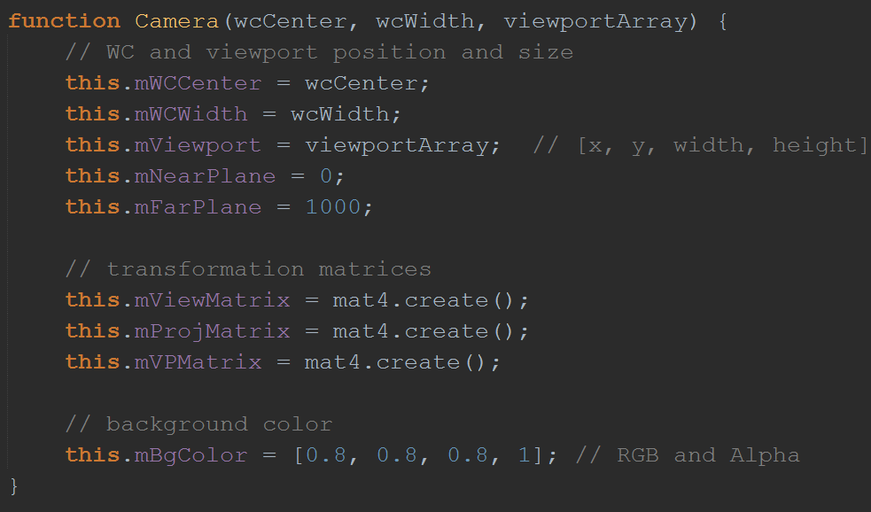
3.5: The Camera Object -- Constructor

Slide 85
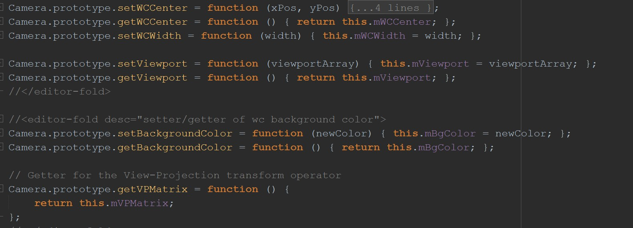
3.5: The Camera – Utility functions

Slide 86
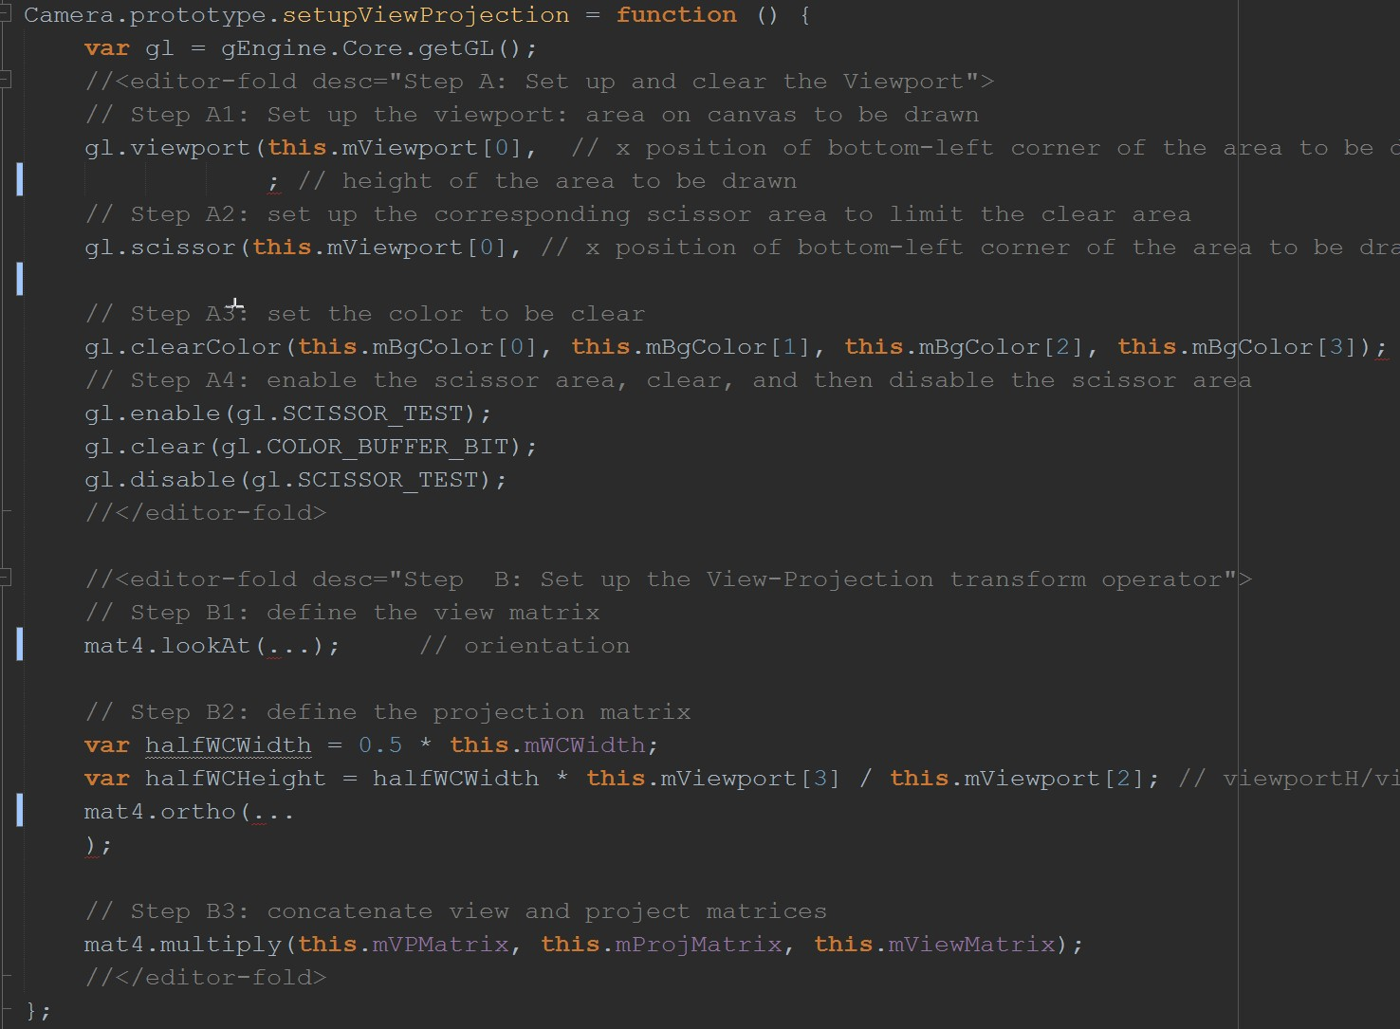
3.5: The Camera – compute vpMatrix

Slide 87
3.5: The Camera –Aspect Ratio

Slide 88
Aspect Ratio of WC and DC must match!

Slide 89
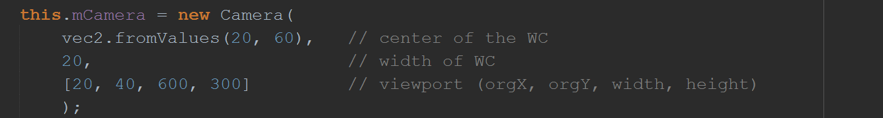
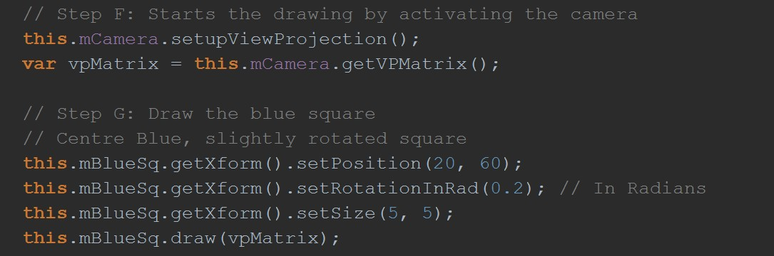
3.5: Testing The Camera
MyGame.js

Slide 90
Chapter 3: Learned?
Transformation and drawing of objects
Coordinate system:
World space
Camera: where to draw from
Viewports: where to draw to

Slide 91
The Game Engine with UI
http://faculty.washington.edu/ksung/2DGameEngine/GameEngineGUI/index.html

